Slide 1
Group – 7
Kartik Nema (IIT2018156)
Bhupendra (IIT2018163)
Prakhar Srivastava (IIT2018172)
Ashish Patel (IIT2018175)
Shubham Soni (IIT2018177)
DETECTION OF IMAGE SPLICING USING IMAGE FORGERY TECHNIQUES

Slide 2
INTRODUCTION
Now days a large number of images are available online, through sites like flickr, facebook. These images are often exposed to threats and adversaries who might use digital image forging techniques to damage these images, or use them in some destructive ways. Few of such common image forging techniques include image retouching forgery, spliced image forgery, copy move forgery. [1]
Copy move forgery :- This involves copying a part of an image and pasting it over another, to hide that part.
Retouching forgery :- Enhances or reduces certain features of an image, generally it is not as dangerous as the other types of forgeries.
Image splicing :- Involves combining two or more images to obtain a new one.
[2]
Problem Statement :- “Detection of image splicing using image forgery technique”

Slide 3
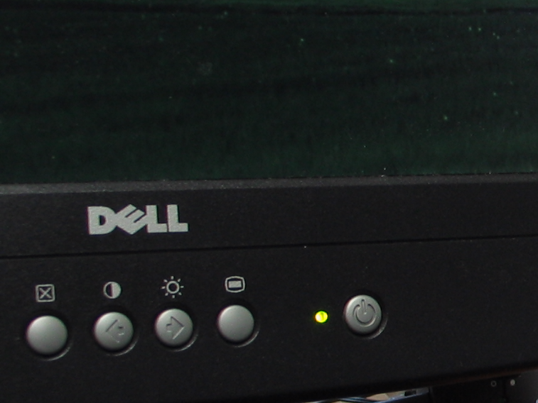

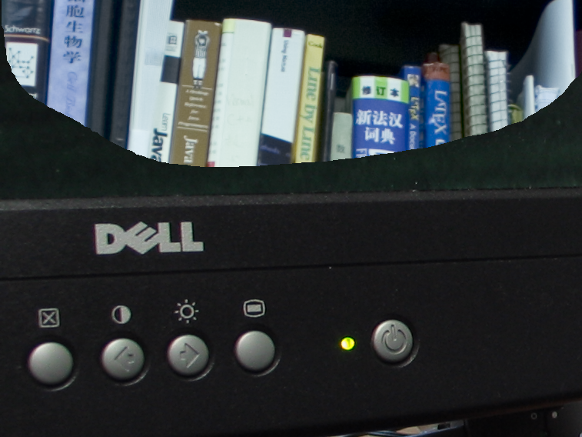
Splicing example
Authentic image 1
Authentic image 2
Spliced image obtained by combining the two authentic images.

Slide 4
Objectives :- In this project we aim to design a system, which takes in an image as input and outputs whether the image is spliced or not. This is a binary classifier i.e. it tells whether the image is spliced (yes or no i.e. spliced or authentic).
Applications and significance of problem :- Detection of image manipulation is extremely important, this is because fraud images can be used as legal evidence, shared on social media etc. Hence with the advent of technology modern image forgery detection techniques have been invented. Determining the authenticity of images i.e. detecting tempering without the presence of any extra information or any embedded watermarks is the challenge of modern times in the field of digital image processing. This project is a step in that direction which attempts to detect image splicing.
Challenges :- Basic challenges and problems involved in achieving a solution to the problem statement include :-
(i) Finding appropriate datasets
(ii) Finding research papers for reference and selecting a base paper
(iii) Choices like finding the appropriate machine learning model for classification.

Slide 5

Literature review
Title | Author | Proposed work
Forgery Detection of Spliced Images Using Machine Learning Classifiers and colour Illumination | Tamana Sharma, Er. Mandeep Kaur | Concept of illumination is used to determine inconsistencies in the image, further classifiers like SVM, LS-SVM are used to make the predictions.
A Review on Splicing Image Forgery Detection Techniques | Chitwan Bhalla Surbhi Gupta | We will just briefly review different methods of forgery detection

Slide 6
Literature review
Title | Author | Proposed work
Image Forgery Identification using Convolution Neural Network | N. Hema Rajini | A technique that merge ZM-polar and block discrete cosine transform as motivated by the Works. Over copy-move forgery and splicing.
Image Splicing Detection via Camera Response Function Analysis | Can Chen, Scott McCloskey, Jingyi Yu | Proposes a method based on Camera Response Function to detect spliced in regions of a forged image with complete automation in patch selection and mask generation

Slide 7
Literature review
Title | Author | Proposed work
Image Forgery Detection Based on statistical features of block DCT coefficient | Shilpa Duaa, Jyotsna Singha, Harish Parthasarathya | Image is converted from RGB to YCbCr colour space and a feature matrix is formed by creating standard deviation and ones for each component and combined. This is passed to the classifiers to identify the image.
Digital image forgery detection using a deep learning approach. | A Kuznetsov | analysis of the image in a sliding window and the classification of each image fragment corresponding to the position of the window

Slide 8
BASE PAPER DESCRIPTION
Title :- Image Splicing Detection via Camera Response Function Analysis [4]
Conference/Journal :- Conference on Computer Vision and Pattern Recognition (CVPR)(2017)
Authors :- Can Chen & Scott McCloskey.
Purpose :- The purpose of the project is to provide an automated method for image forgery detection using plotting of Intensity Gradient Histogram using Camera Response Function.

Slide 9
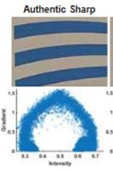
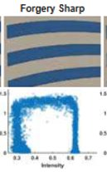
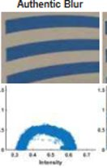
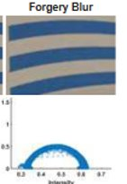
BASE PAPER METHODOLOGY :-
If the plot is symmetric and image is sharp then it is classified as authentic
If the plot is asymmetric and image is blur then it is classified as authentic
If the plot is symmetric and image is blur then it is classified as Forged image.
If the plot has a rectangular shape and image is sharp then the image is forged image.
[4]

Slide 10
PROPOSED METHODOLOGY
Feature Extraction:
The CUISDE Dataset used here is not fit for training a model.
The mask is used to sample the fake image along the boundary of the spliced image.
The image is converted to grayscale and then it is further converted to binary image using Otsu’s thresholding.
Sampling is done by creating a window of 64X64 and moving it through the fake image and counting the number of zero valued pixels.
Since the data was too large therefore different batches are created
Each batch consists of the data frame for 10 images. So, 16 batches are created from the CUISDE Dataset.

Slide 11
PROPOSED METHODOLOGY
Classification:
Collected data is classified using CNN.
First the data is splitted in Testing and Training data in the ratio of 1:4 respectively.
This data is trained on the training dataset.
Then to predict the labels in the test dataset it is passed through predict function.

Slide 12
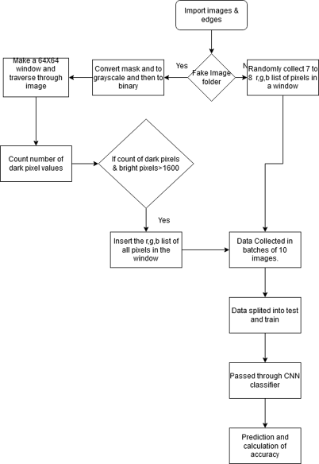
Proposed Methodology

Slide 13
IMPLEMENTATION DETAILS
The project contains 3 files (excluding the readme), the 2 files are :-
PreProcessing.py (python file)
Classify.ipynb (python notebook)
sample_output.py (python file)
Software & Hardware Requirements
The code was developed (in addition to Google Colab) on local system having the following specifications :-
RAM :- 8 GB
Intel Core i5 processor
1 TB hard disk drive
Operating Systems :- Windows 10 (64 bit), Linux Ubuntu (LTS 18.04)

Slide 14
1. Preprocessing.py:
Step 1: The paths for the authentic and forged images are created.
Step 2: All the fake images and their masks are passed to the extractWindowFake function which makes a window of 64X64 and counts the number of dark valued pixels in the mask image.If it is greater than a certain value then it is inserted into the ‘data’ section.
Step 3: All the authentic images are passed to the extractWindow function again in which a window is created and is traversed through the image. But here the R,G,B components of the image(in a window) are stored and returned.
Step 4: The data generated by these two functions are stored in a pickle file.Since the data was too large therefore the preprocessing stage code was implemented batch wise.
Step 5: After generating the pickle files for all the batches they were stored in Google Drive.

Slide 15
2. Classify.ipynb:
Step 1: The folder which contains all the pickle files is connected to the runtime of the Colab.
Step 2: The dataset is loaded into the dictionary dic from all the pickle files.The data and tag contains the dic[‘data’] and dic[‘tag’] respectively.
Step 3: The dataset is then splitted into training and testing data in the ratio of 4:1.
Step 4: The CNN classifier is further trained on the training data in 50 iterations and 32 batch size.
Step 5: For prediction x_test is passed to the predict function which will return an array.The values are rounded off. If it comes out to be 0 then the image is authentic else forged.
Step 6: To measure the accuracy predicted array is compared to the y_test and counting the number of correctly predicted values.
We observe that the accuracy by this method comes out to be 68.43%.

Slide 16
3. sample_output.py:
Step 1: Provides a GUI for the user to interact with our project.
Step 2: It provides options like file explorer (to select the target image), load dataset (for final classifcation).
To get outputs on our local machine, we had to consider only a fraction of the total dataset (7 out of 16 pickle files) because of memory errors. Also on our local machines we had to use RandomForest Classification, since CNN wasn't running.
Step 3: When the user runs this file, a window will pop out.
Step 4: Once the user has loaded the dataset and selected the image he/she should press the classify image button, and wait for some time to get the output.
Step 5: After some delay the user will obtain output for the image (spliced or authentic).

Slide 17

Dataset Description
We used the Columbia Uncompressed Image Splicing Detection Dataset (CUISDE Dataset) [9]
It contains two folders one having 183 authentic images and another containing 180 spliced images. The images cover both indoor and outdoor settings. They were taken using a variety of cameras like canon, nikon etc.
CUISDE contains 183 authentic and 180 spliced images and the masks.
Following are samples from the CUISDE dataset, the one on left is a spliced image present in the 4cam_splc folder, while the one on right is authentic present in the 4cam_auth folder.
Also each folder contains a sub-folder named edgemasks which stores edgemasks for all the images in the original directory, i.e. the dataset contains edgemasks for all the images be they spliced or authentic.

Slide 18
LANGUAGE & LIBRARIES
Language :- Python (Python 3)
Tools and Libraries :-
For development purposes we used coding environments like Google Colab, PyCharm, Jupyter Notebook.
A number of text editors like sublime text, Atom, Notepad++, VS code etc. Were used.
Libraries include openCV, PIL, sklearn, numpy, pandas, matplotlib, tkinter, keras etc.

Slide 19
Final Project and Results

Slide 20
Accuracy
To test our model we divided the dataset into two parts one containing 80% of samples used for training and one having 20% for testing. For this purpose of splitting the dataset into 2 parts we use sklearn’s train_test_split. On testing our model on the above mentioned test set (20% of entire dataset), we get an accuracy of 68.43%.

Slide 21
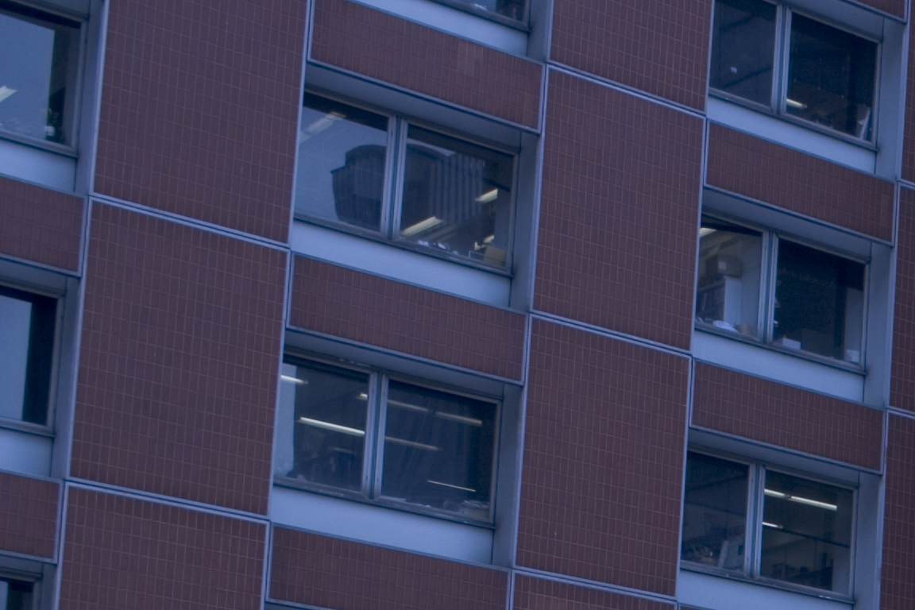
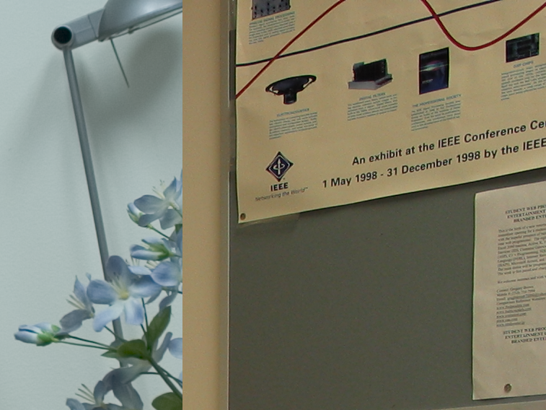
Input/Output
Verdict : Spliced
Expected : Spliced
Verdict : Authentic
Expected : Authentic
Verdict : Spliced
Expected : Spliced
Images taken from CUISDE dataset [9]

Slide 22
Comparison with other models.
Paper Title | Author(s) | Accuracy
A Review on Splicing Image Forgery Detection Techniques [2] | Chitwan Bhalla, Surbhi Gupta | 97%
Image Forgery Identification using Convolution Neural Network [3] | N. Hema Rajini | Spliced image detection using the SVM has attained an accuracy of 85-86%. CNN accurately classifies with an accuracy of 99.03%.
Image Splicing Detection via Camera Response Function Analysis [4] | Can Chen, Scott McCloskey, Jingyi Yu | According to the results, CNN classifiers on IGH give an accuracy of 97% on CUISIDE dataset,99% in SpLogo dataset and 97.8% on the combination of the two datasets.
Digital image forgery detection using deep learning approach [6] | A Kuznetsov | 97.8%
Image Forgery Detection Based on statistical features of block DCT coefficients [7] | Shilpa Duaa, Jyotsna Singha, Harish Parthasarathya | 98%

Slide 23
Comparison with earlier published work
Our earlier model was not able to predict for a single image.
Since we had not added the functionality for Input and Output testing.
Although we had tried to just classify a single image but our model was not able to predict it correctly.
This time we have added the functionality for Input and Output.
It predicts some of the images from the CUISDE dataset almost correctly since our accuracy is around 68.5%

Slide 24
ACTIVITY SCHEDULE
Work done before C-II
23rd August – 28th August
Searching and analysing papers for reference. (duration 1 week starting from August 23rd).
1st September - 10th September
Identifying an overall structure for how the project should look like and function.
Learning some of the basic machine learning algorithms mentioned in the papers.
Learning the basics of open cv, and other python libraries like PIL used for image processing
Exploring datasets.
SRS compiled between 6th and 10th September (report and ppt).
10th September - 11th September
Recompiled on 11th to include 2 additional research papers.

Slide 25
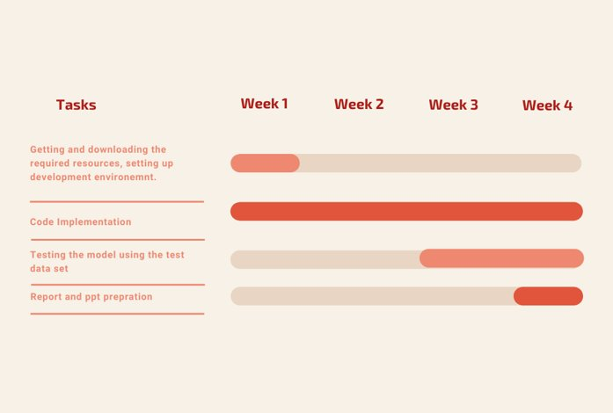
ACTIVITY CHART
WEEK 1 –
27 Sep to 4 Oct
WEEK 2 –
4 Oct to 11 Oct
WEEK 3 –
11 Oct to 18 Oct
WEEK 4 –
18 Oct to 25 Oct
Clearer image can be found here

Slide 26
ACTIVITY SCHEDULE
Work done After C-II
3rd November – 7th November
Trying other machine learning models like Random Forest Classification
Preparing GUI for user interaction
Pickling the model for compatibility and ease of use
12th November – 15th November
Report and presentation compilation and submission

Slide 27
Conclusion and Future scope
So here, we provide a method to distinguish between an authentic and a spliced image.
We worked on the CUISDE dataset and attained an accuracy of 68.43%.
We used CNN model for classification in which first all 64*64 windows are considered and the model is trained on training dataset.
We also added a GUI for easy classification of a single image. It takes a single image and classifies it as authentic or spliced.
This tool can also be modified to not just only classify as spliced or authentic but also if the image is fake then the boundary at which it is spliced can be highlighted.
In other words a mask can also be determined for the fake image. This tool can be used in forensics to detect for an authentic or fake image.

Slide 28

References
[1] Tamana Sharma, Er.Mandeep Kaur “Forgery Detection of Spliced Images Using Machine Learning Classifiers and color Illumination”, International Journal of Innovative Research in Science, Engineering and Technology http://www.ijirset.com/upload/2016/june/186_54_Forgery.pdf
[2] Chitwan Bhalla Surbhi Gupta, “A Review on Splicing Image Forgery Detection Techniques”, International Journal of Computer Science and Information Technology & Security (IJCSITS), ISSN: 2249-9555 Vol.6, No.2, Mar-April 2016 https://pdfs.semanticscholar.org/f6a9/877a29d2b90601d320cabe491c16ddc0270a.pdf
[3] N. Hema Rajini, “Image Forgery Identification using Convolution Neural Network” ,International Journal of Recent Technology and Engineering (IJRTE) ISSN: 2277-3878, Volume-8, Issue-1S4, June 2019 https://www.ijrte.org/wp-content/uploads/papers/v8i1s4/A10550681S419.pdf

Slide 29
References
[4] Can Chen, Scott McCloskey, Jingyi Yu, “Image Splicing Detection via Camera Response Function Analysis”, Computer Vision foundation https://openaccess.thecvf.com/content_cvpr_2017/papers/Chen_Image_Splicing_Detection_CVPR_2017_paper.pdf
[5] Diaa M. Uliyan, Mohammad T.Alshammari, “Investigation of image forgery based on multiscale retinex under illumination variations”, Department of Information and Computer Science, College of Computer Science and Engineering, University of Ha'il, Ha'il, 81481, Saudi Arabia https://www.researchgate.net/publication/341728677_Investigation_of_image_forgery_based_on_multiscale_retinex_under_illumination_variations
[6] A Kuznetsov, “Digital image forgery detection using deep learning approach”, Journal of Physics: Conference Series https://www.researchgate.net/publication/337550730_Digital_image_forgery_detection_using_deep_learning_approach

Slide 30
References
[7] Shilpa Duaa, Jyotsna Singha, Harish Parthasarathya, “Image forgery detection based on statistical features of block DCT coefficients”, Third International Conference on Computing and Network Communications (CoCoNet’19) https://www.sciencedirect.com/science/article/pii/S1877050920310048
[8] Jing Dong, Wei Wang and Tieniu Tan, “CASIA IMAGE TAMPERING DETECTION EVALUATION DATABASE”, Institute of Automation, Chinese Academy of Sciences P.O.Box 2728, Beijing, 10190 http://ir.ia.ac.cn/bitstream/173211/12318/1/06625374.pdf
[9] Y.-F. Hsu and S.-F. Chang. Detecting image splicing using geometry invariants and camera characteristics consistency. In 2006 IEEE International Conference on Multimedia and Expo, pages 549–552. IEEE, 2006”. Columbia Uncompressed Image Splicing Detection Dataset is available here.
[10] https://towardsdatascience.com/image-forgery-detection-2ee6f1a65442

Slide 31
THANK YOU

